Slide 2
It's C# All The Way Down! Using .NET for Home Automation with IoT Devices
Sammo Gabay
Senior Software Engineer, Motorola Solutions
sammo@sammo.ga
www.sammo.ga
github.com/burkenyo

Slide 3
.NET Runs Almost Everywhere!
Single Board Computers
Raspberry Pi
BeagleBoard
Microcontrollers
Espressif ESP32 (Xtensa)
ARM Cortex-M
AVR family

Slide 4
SBCs and MCUs
Single-Board Computer
Small footprint
Moderate processing power
32-bit/64-bit
ARM (or x86) instruction set
Runs Linux
Low cost
Runs full .NET runtime
Microcontroller
Minimal footprint
Less powerful
16-bit/32-bit
Various instruction sets
Runs lightweight RTOS
Minimal cost
Runs .NET nanoFramework

Slide 5



What is .NET nanoFramework?
Continuation of .NET Micro Framework
Supported by .NET Foundation
Compact subset of .NET runtime APIs
Supports some modern C# features
File-scoped namespaces
Top-level statements
Record types (relies on IEquatable<T>)
Specialized CLR implementations for MCUs
Additional targets added routinely

Slide 6
Two Flavors of .NET
Full .NET runtime
Moderate footprint
~10s of MBs memory
Full range of APIs
Both feature NuGet packages for sensors and other IO devices
.NET nanoFramework
Tiny footprint
<1MB of memory
Limited subset of APIs
Fundamental types
Threading
Networking

Slide 7
Example Project
90s-era Gravis Gamepad with legacy game port interface
Digital pins of buttons, analog pins for D-pad
ESP32-S2 based microcontroller running .NET nanoFramework
Reads gamepad state via GPIO and sends out pulses over WiFi
Communicates via the lightweight pub/sub protocol MQTT
Raspberry Pi 4 running full .NET runtime (ASP.NET Core)
Processes pulses and calls REST APIs for IoT devices

Slide 8

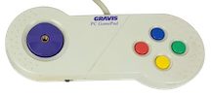
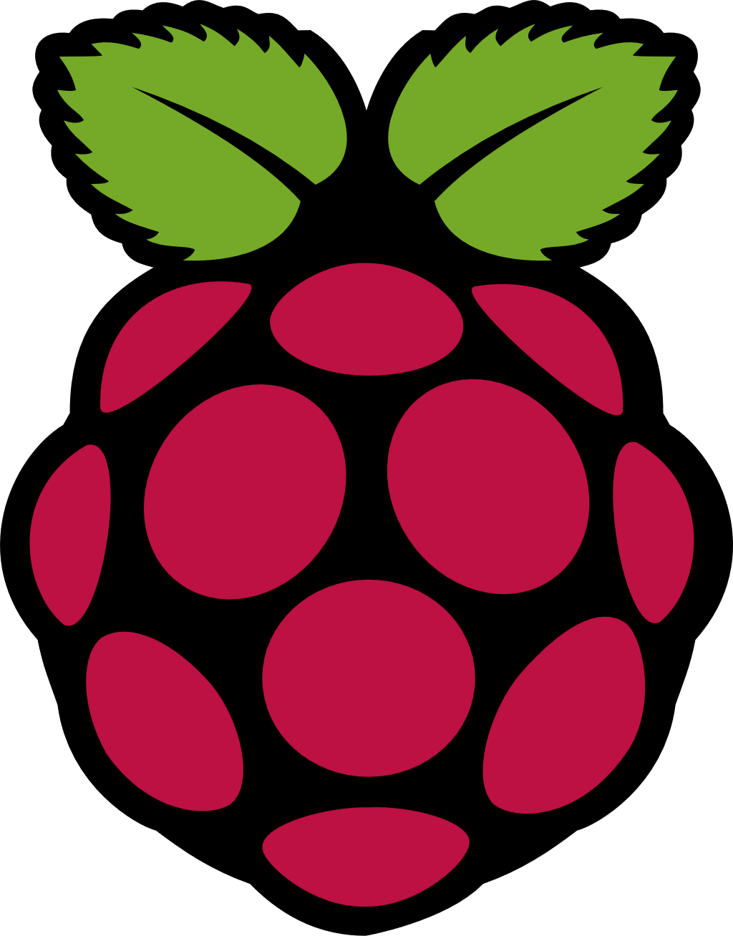

Example Project
wired connection
wireless connection
GPIO
ESP32-S2 MCU
nanoFramework
game pad
MQTT
Raspberry Pi
.NET 8 runtime
REST API
smart bulb

Slide 9
Demo Time!

Slide 10

Resources
.NET IOT Resources https://dotnet.microsoft.com/apps/iot
.NET nanoFramework https://www.nanoframework.net
Sample Project https://github.com/burkenyo/Burkenyo.Iot

